Slide 1
SILENT FEATURES
Menu Driven, Key Board and Mouse Navigation.
Paperless Practice.
Improve Efficiency, Productivity.
Cost Effective Solutions.
Graphical User Interface With Context Sensitive Help.
No Special Training Needed For Using The System.
Provides multi user environment.

Slide 2
MODULES
Database Operations.
Initial Records.
Transaction Management.
Inventory Management.
Accounting.
User Management.

Slide 3
DATABASE OPERATIONS
All operations relating to database is carried out in this module
Including :-
Create/Adding
Edit/ Delete
Back up
Restore

Slide 4
SEHRA MEDICAL STORE
USER MANAGEMENT
The module in which various users of SEHRA MEDICAL STORE are created. Different privilege levels can be assigned to each user for providing high security
So it Includes :-
User creation
Privilege Setting

Slide 5
AUTOMATION OF
MEDICAL
STORE
Some Screen Shots

Slide 6
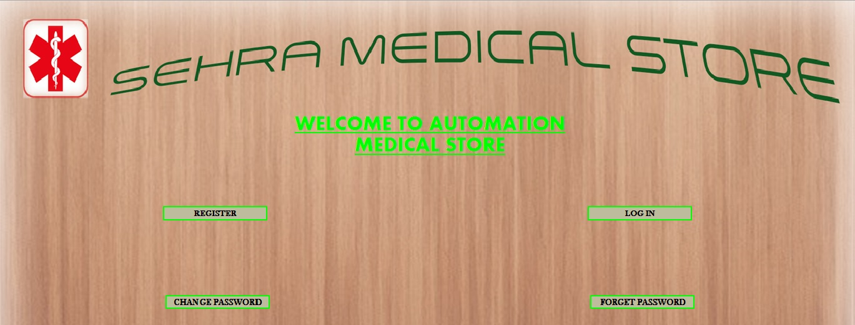
SEHRA MEDICAL STORE
FRONT LAYOUT FORM

Slide 7
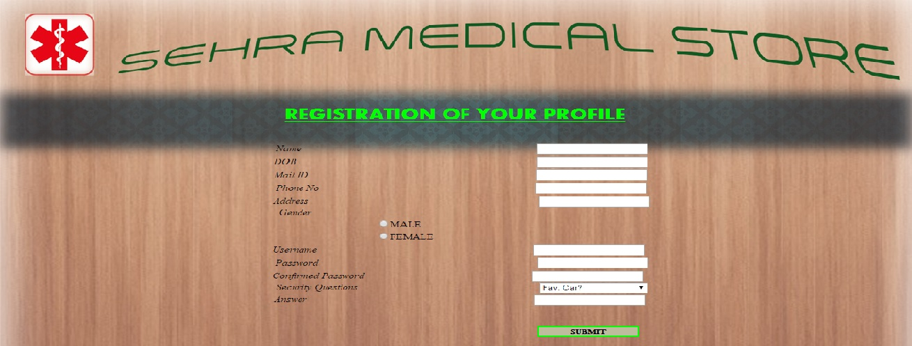
SEHRA MEDICAL STORE
REGISTRATION FORM

Slide 8
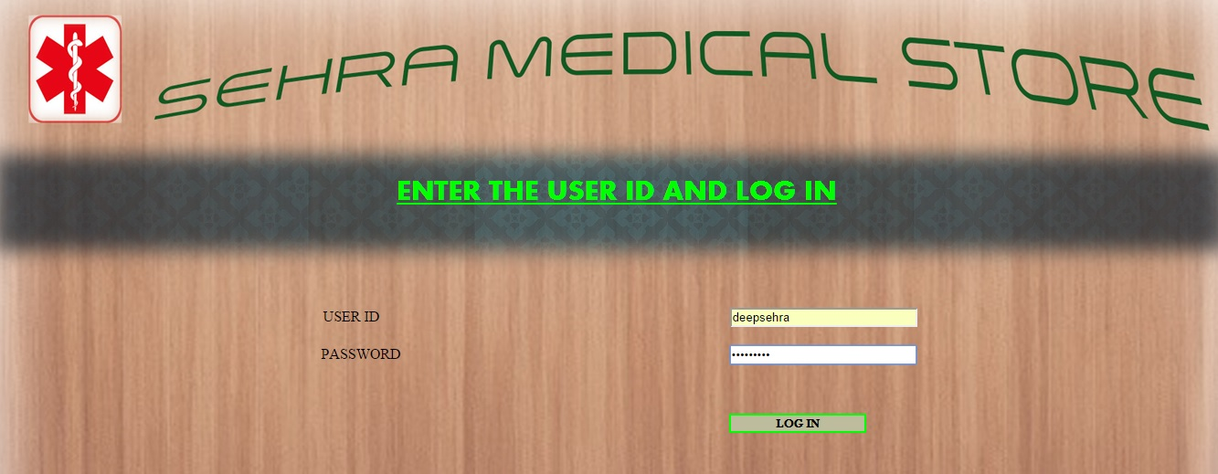
SEHRA MEDICAL STORE
LOGIN FORM

Slide 9
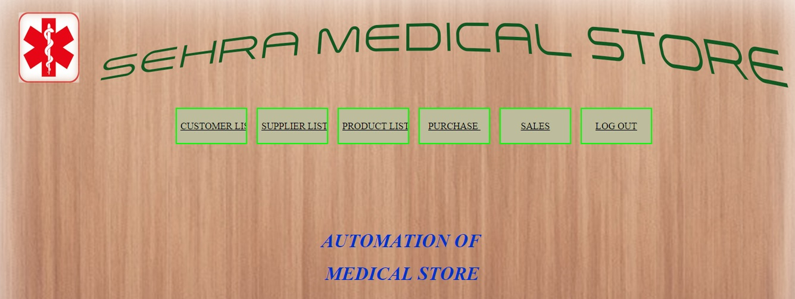
SEHRA MEDICAL STORE
AMS FORM

Slide 10
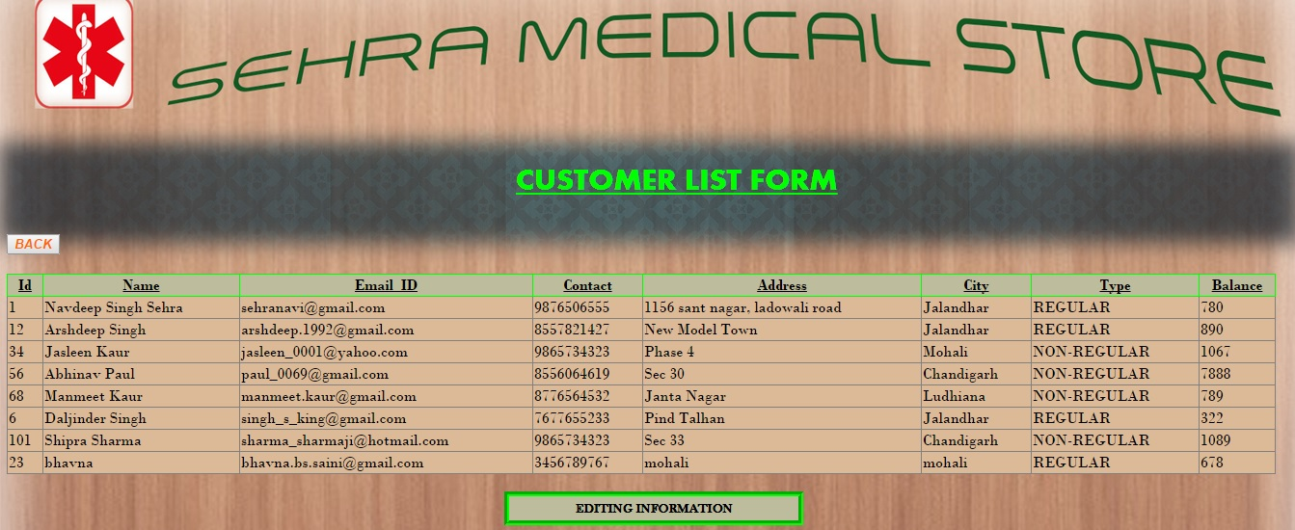
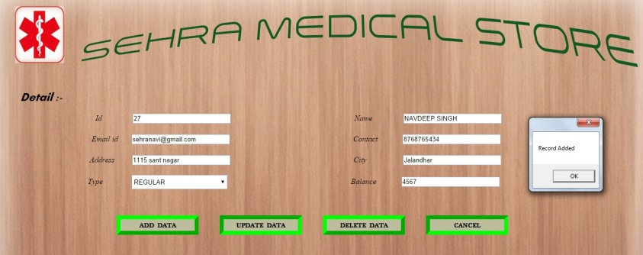
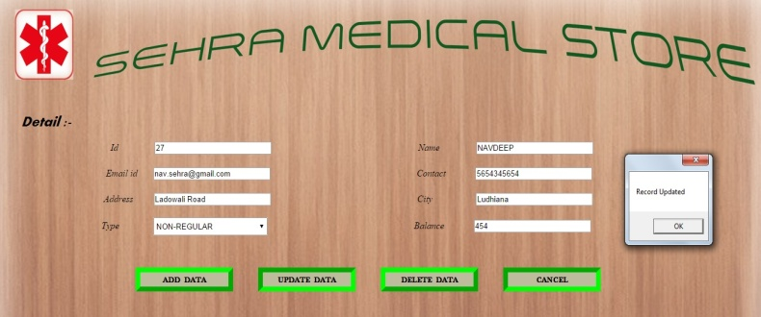
SEHRA MEDICAL STORE
CUSTOMER LIST FORM
FOR ADDITION
FOR UPDATE

Slide 11
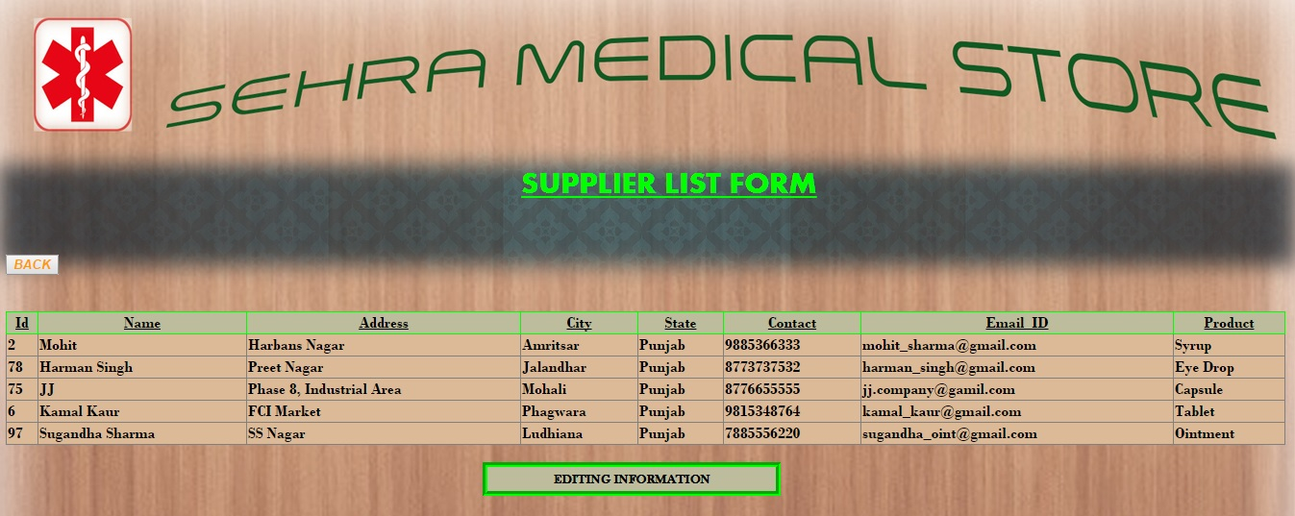
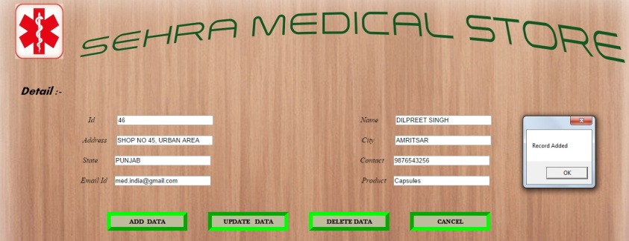
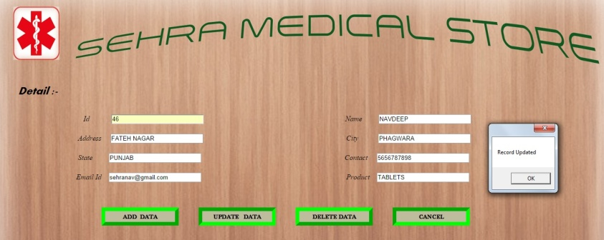
SEHRA MEDICAL STORE
SUPPLIER FORM
FOR ADD
FOR UPDATE

Slide 12
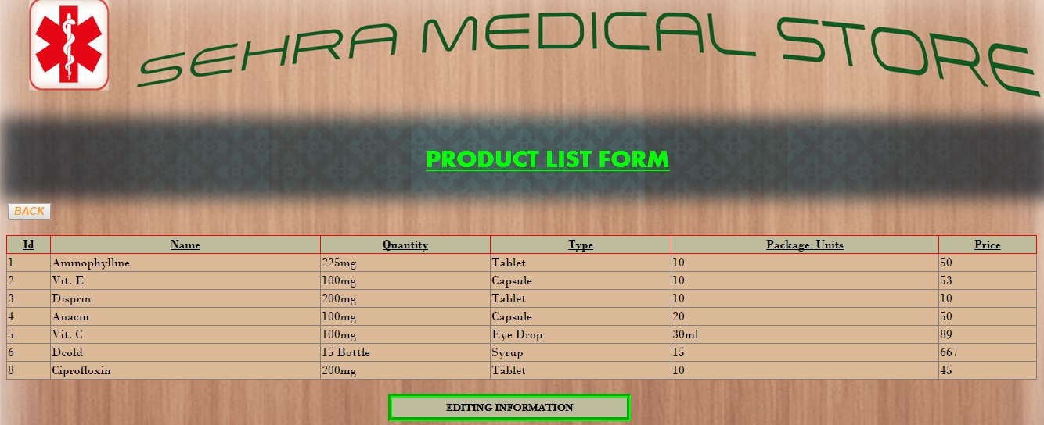
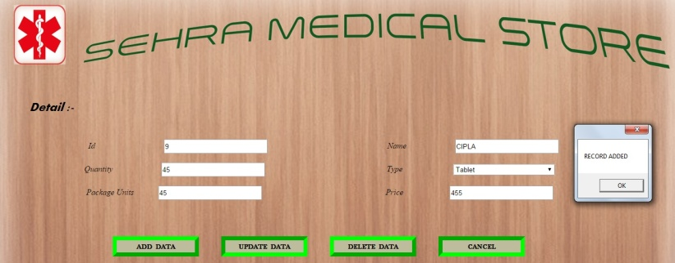

SEHRA MEDICAL STORE
PRODUCT LIST FORM
FOR ADD
FOR UPDATE

Slide 13
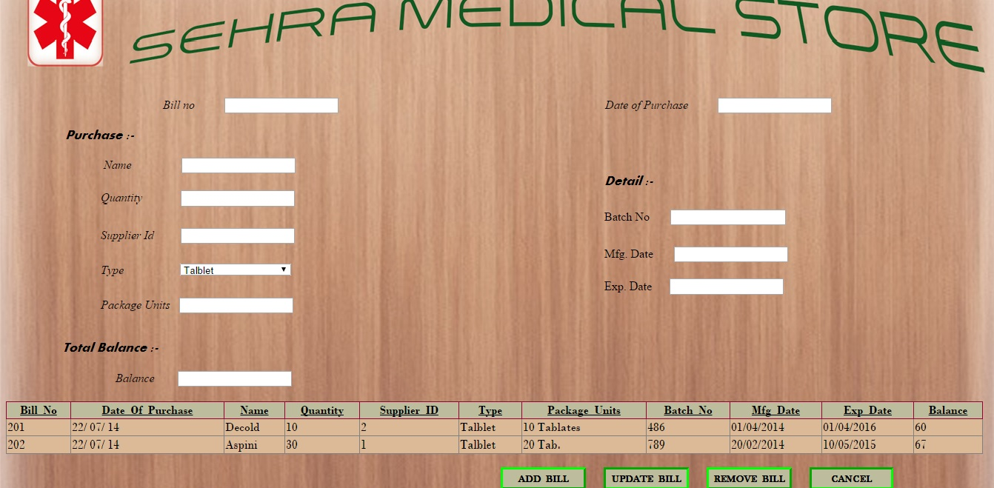
SEHRA MEDICAL STORE
PURCHASE BILL FORM

Slide 14
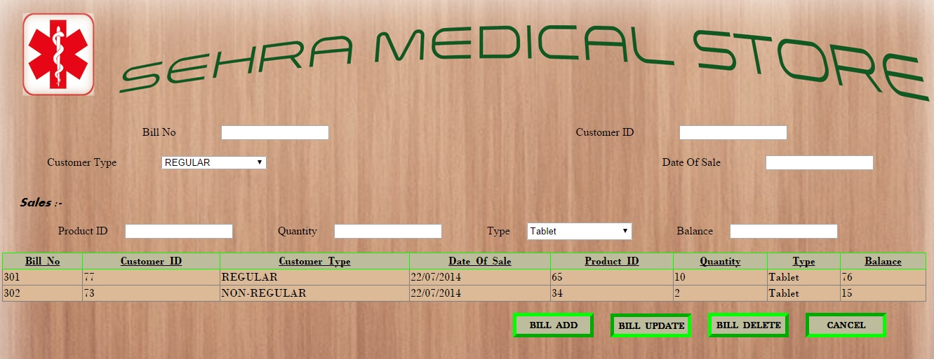
SEHRA MEDICAL STORE
SALES BILL FORM

Slide 15
THANK YOU

